Slide 1

Bauer Bot
Bauer Bot
By- Arfat Kamal Sahat al Ferdous Fahim
Md Saidur Rahman Tasawar Siddiquy

Slide 2
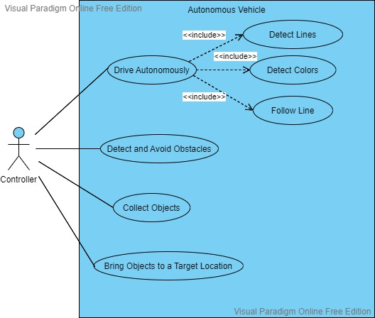
Use Case Diagram

Slide 3
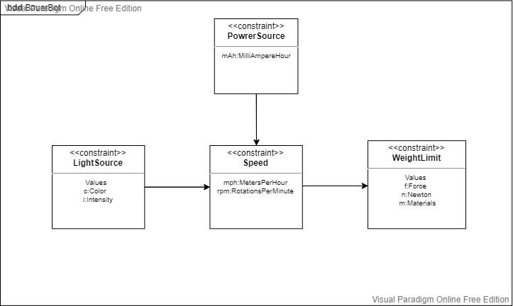
Constraint Diagram

Slide 4
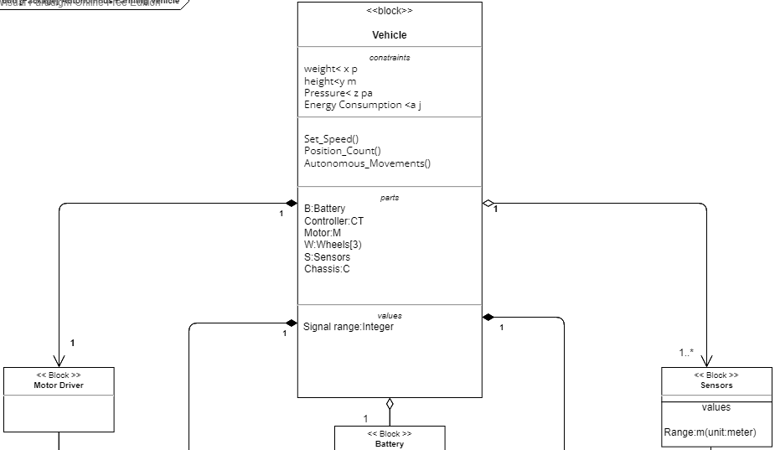
Block Diagram

Slide 5

Block Diagram

Slide 6
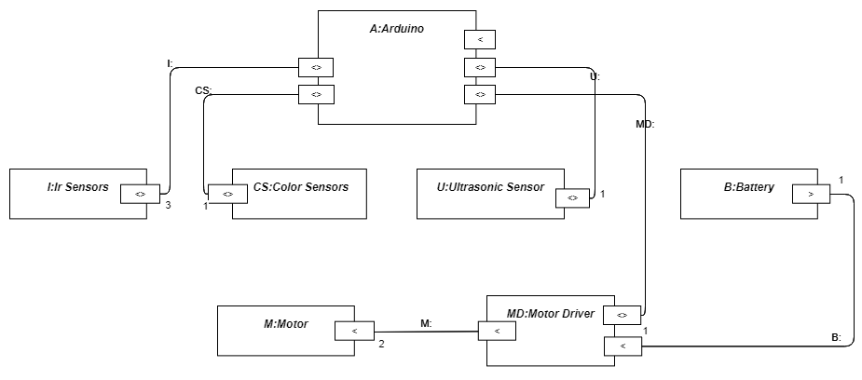
Internal Block Diagram

Slide 7
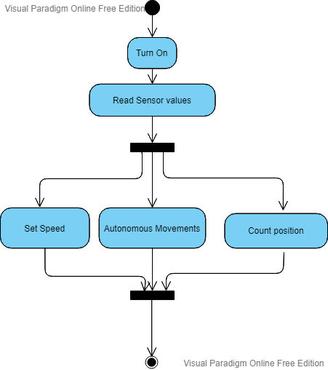
Activity Diagram

Slide 8
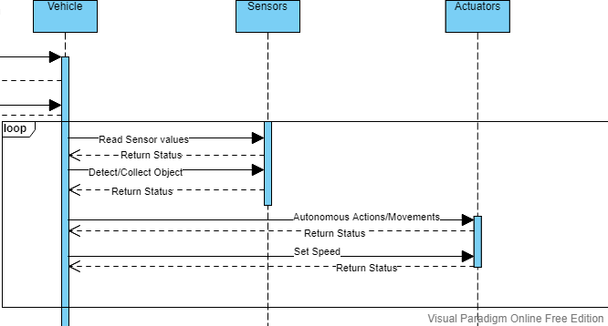
Sequence Diagram

Slide 9
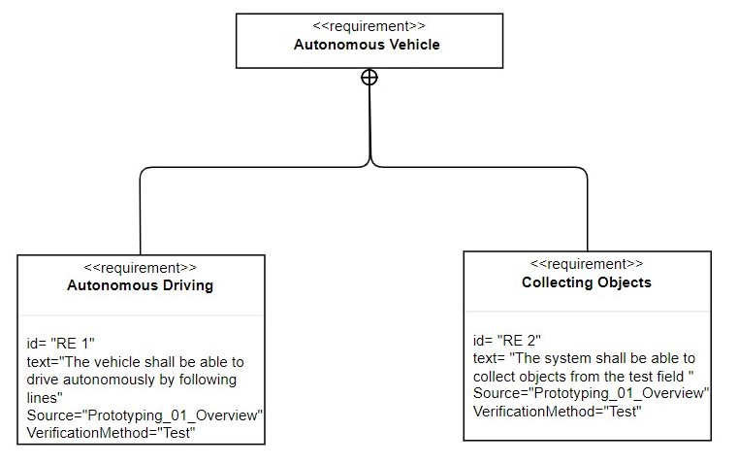
Requirement Diagram

Slide 10
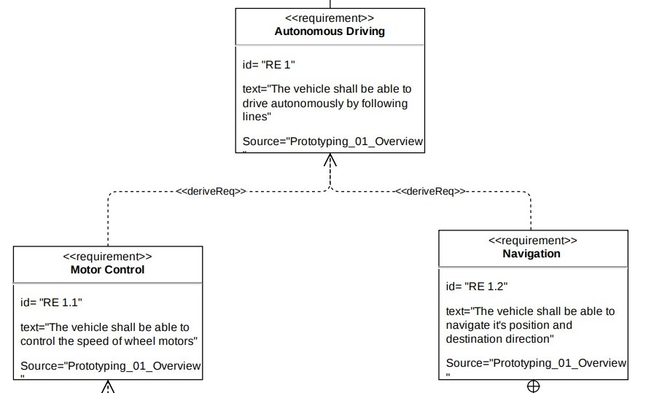
Requirement Diagram

Slide 11
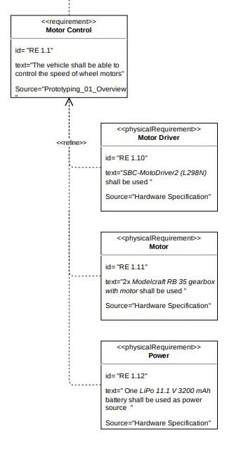
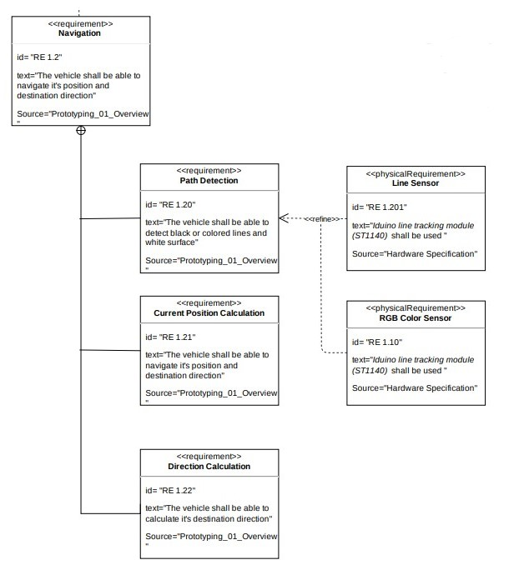

Slide 12
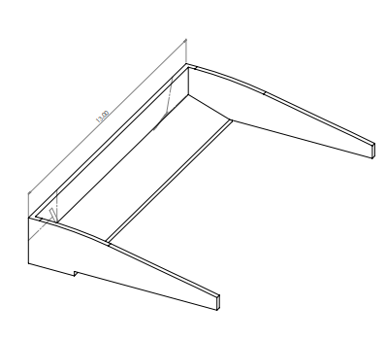
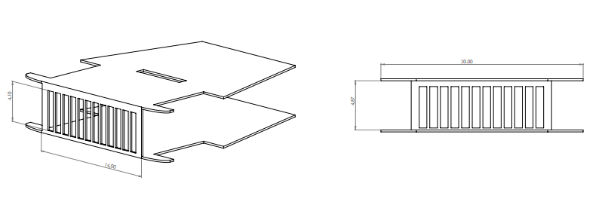
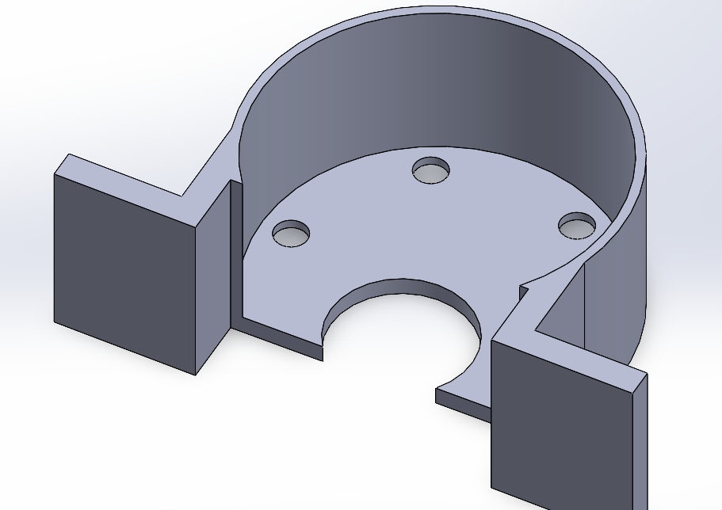
Important Design Parts

Slide 13
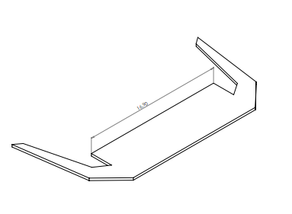
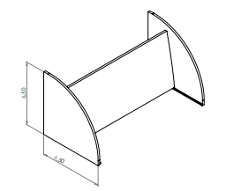
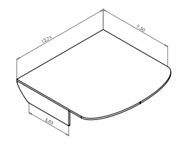
Important Design Parts

Slide 14
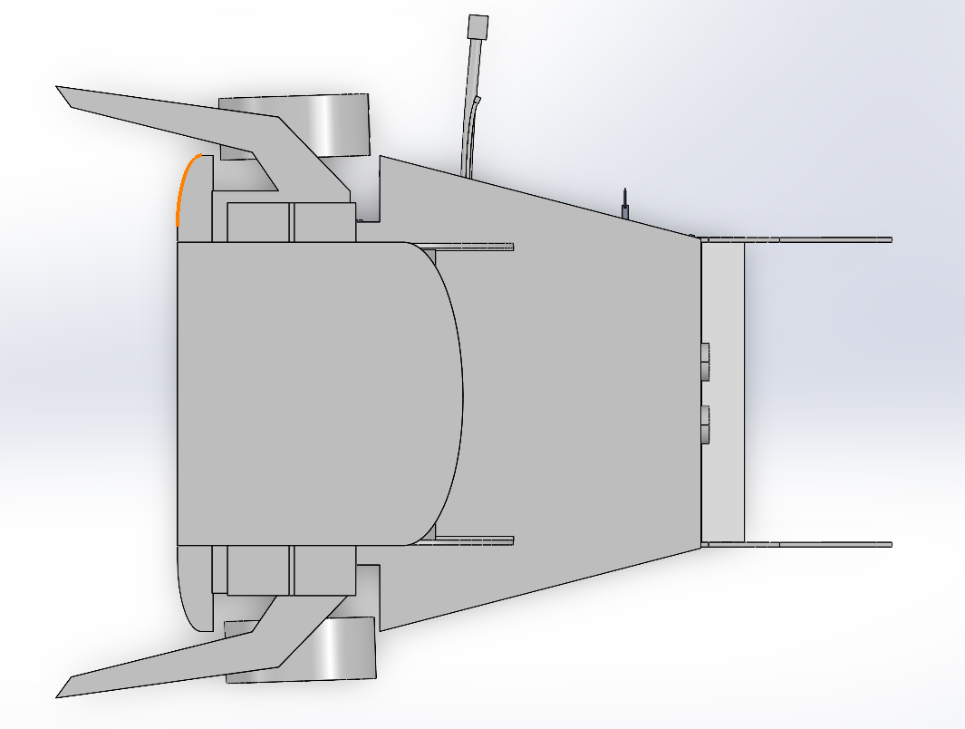
Top View

Slide 15
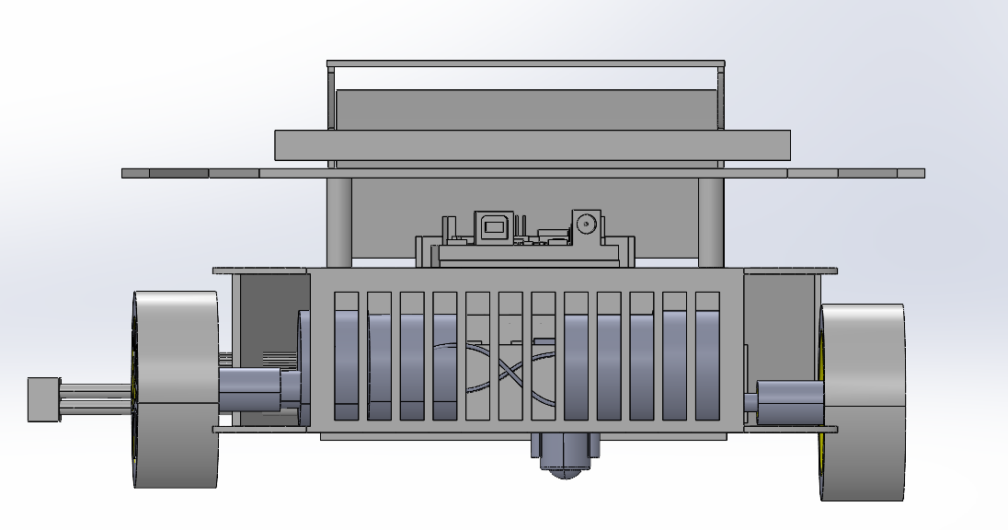
Rear View

Slide 16
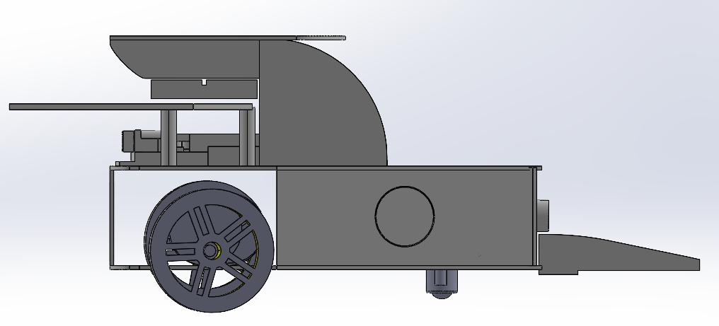
Side View

Slide 17
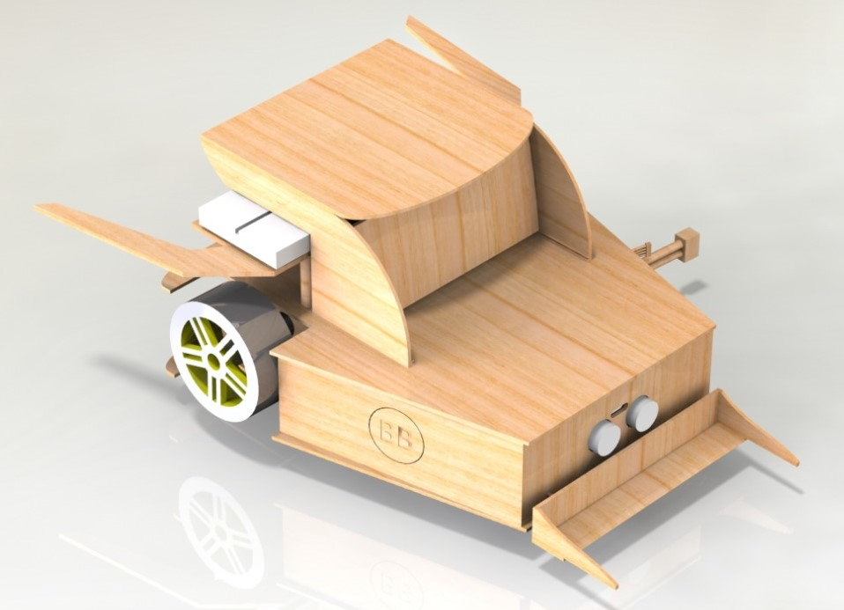
Final Model

Slide 18
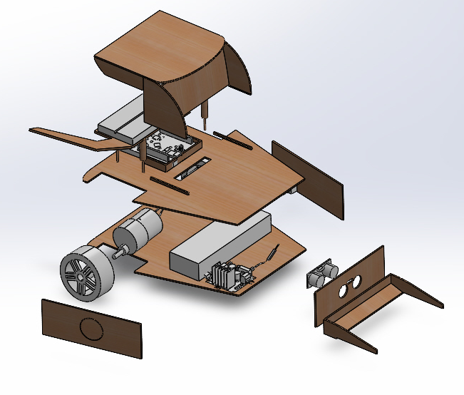
Exploded View

Slide 19
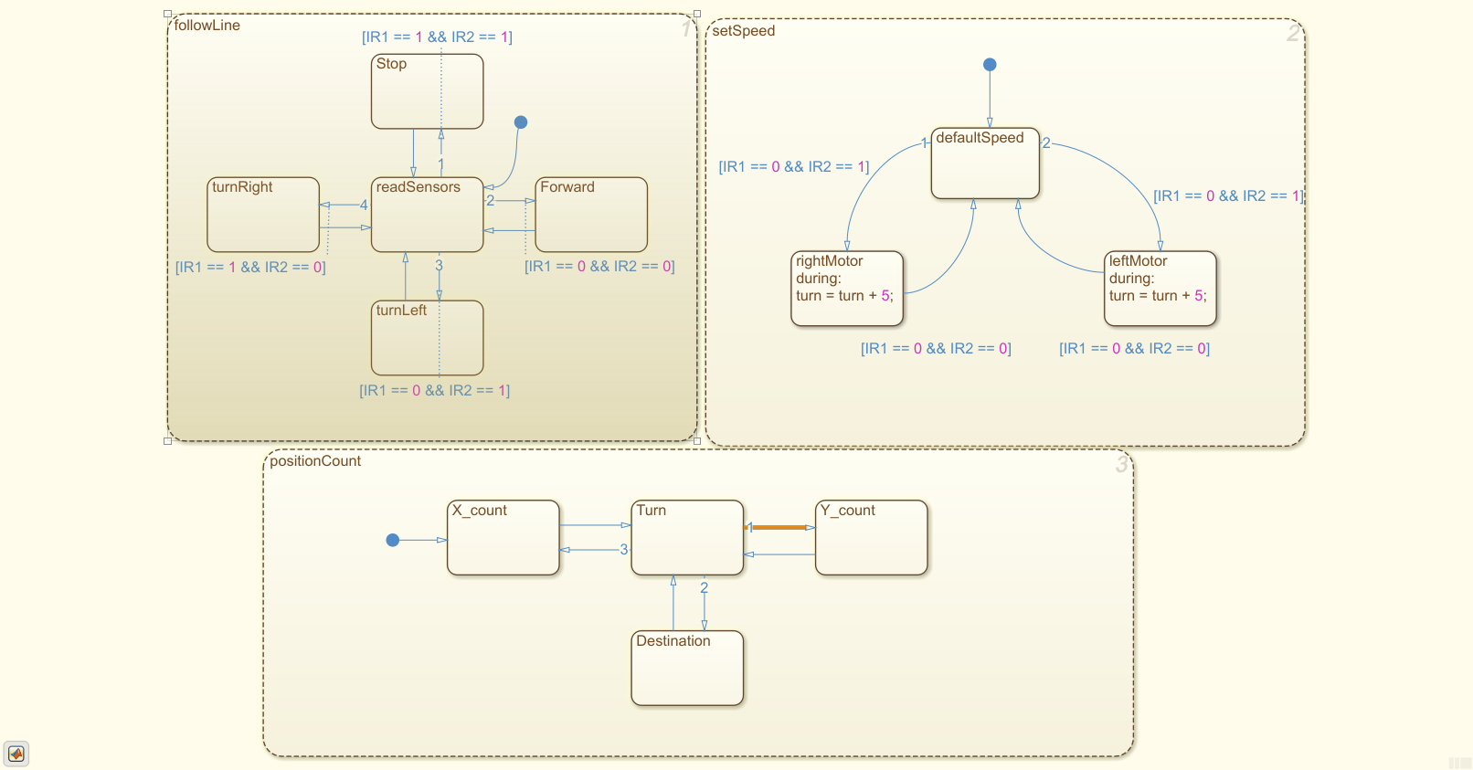
Three concurrently running tasks

Slide 20
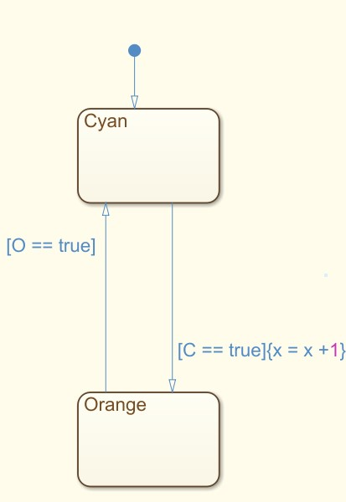
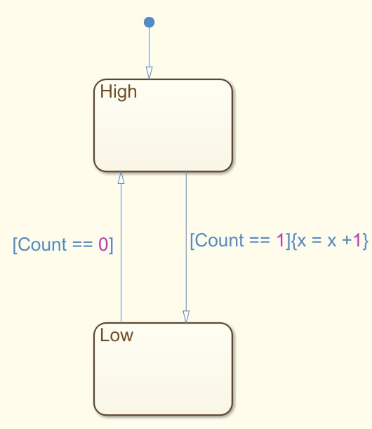
Two different way of implementation
(4,0)
(4,0)
(3,0)
(3,0)
(2,0)
(2,0)
(1,0)
(1,0)
Y
Y
X
X
(0,0)
(0,0)
RGB color sensors
Line sensors

Slide 21

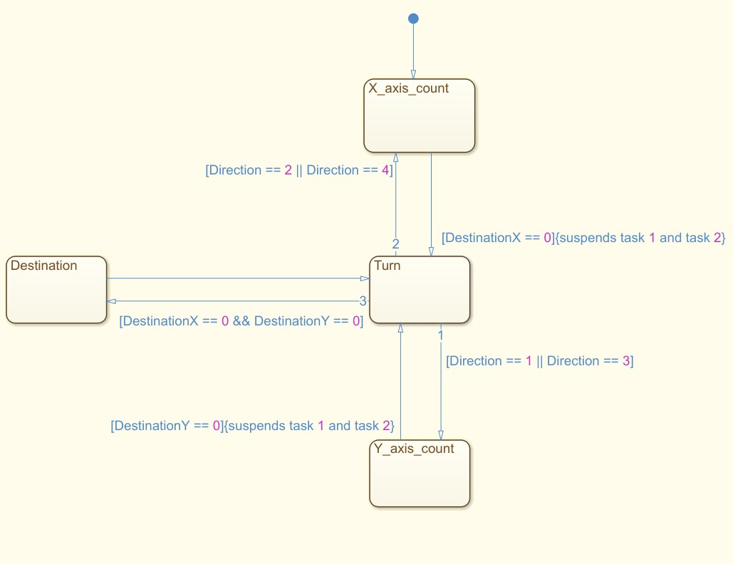

1
Implementation
2
4
3
(2,2)
(2,0)
(0,0)
DestinationX = (targetX – currentX)
DestinationY = (targetY – currentY)
Task: positionCount

Slide 22
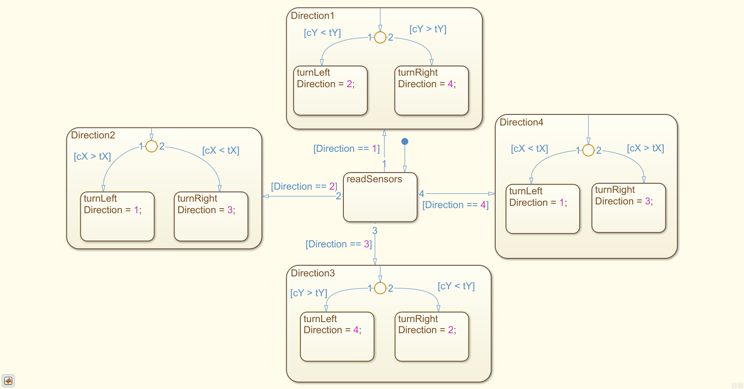
1
Implementation
2
4
3
(2,2)
(2,0)
(0,0)
Y
X
State: Turn

Slide 23
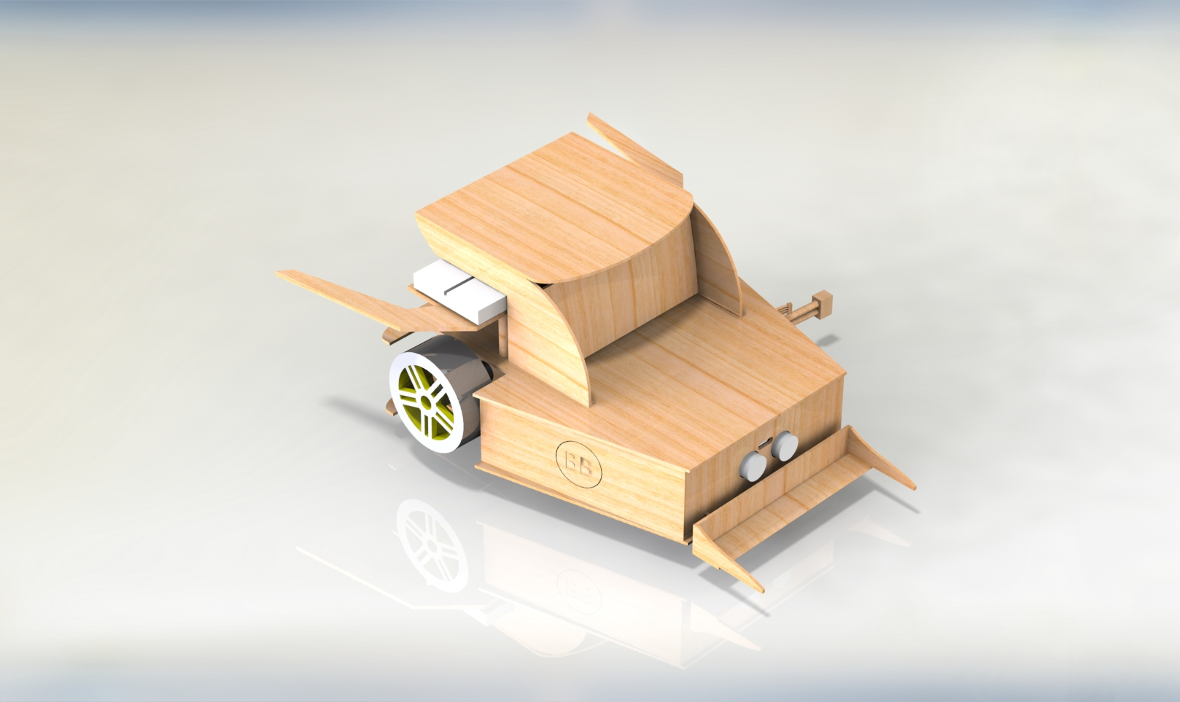

Slide 26
case 1: // initially car is looking at direction 1
if (currentY < targetY)
{
if (count == 0 && IR1 == 0 && IR2 == 1) // left turn has been completed after this conditions are met
{
turnManagerY(); // This fuction resumes line follow and speed set task after completing the turn. it also exit turning state
direction = 2; // seting the direction at 2 after turning left
} else {
forward_left();
}
}
else if (currentY > targetY)
{
if (count == 1 && IR1 == 1 && IR2 == 0) // right turn has been completed after this conditions are met
{
turnManagerY();
direction = 4;
} else {
forward_right();
}
}
break;

Slide 27
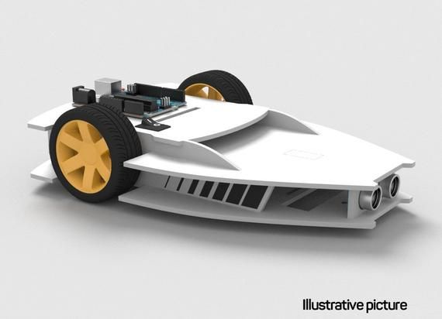

Slide 28
